Slide 1
Management and Organization of Online Classes: Challenges and Opportunities
By
Dr. Sheikh Abu Reza
Former Director (P&D), DTE &
CBT&A Trainer

Slide 2
Management and Organization of Online Classes: Challenges and Opportunities
The COVID-19 pandemic disrupted education worldwide, affecting 91% of students.
Schools, Institutes and universities shifted rapidly to online learning due to closures.
This sudden change encouraged innovation and use of digital tools.
The crisis may accelerate a long-term shift toward tech-driven education

Slide 3
Main Challenges & Opportunities of organizational behavior are:
Developing digital skills and competencies of participants
Maintaining quality and productivity in virtual learning
environments
Applying effective quality management practices online
Managing diversity in virtual classrooms
Encouraging collaboration through online tools

Slide 4
Challenges & Opportunities (Cont..)
Empowering learners and improving virtual support services
Promoting ethical behavior in digital interactions
Adapting to the fast-changing online learning landscape
Stimulating innovation in teaching methods and technology use
Balancing online learning with personal and professional life

Slide 5
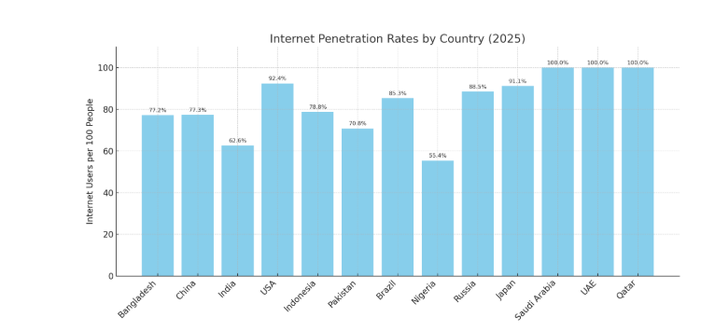
Internet Penetration Rates by Country in 2025 users per 100 people

Slide 6
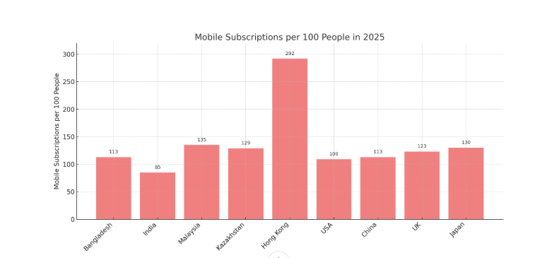
Mobile subscriptions per 100 people in 2025

Slide 7

Boat schools in Bangladesh

Slide 8
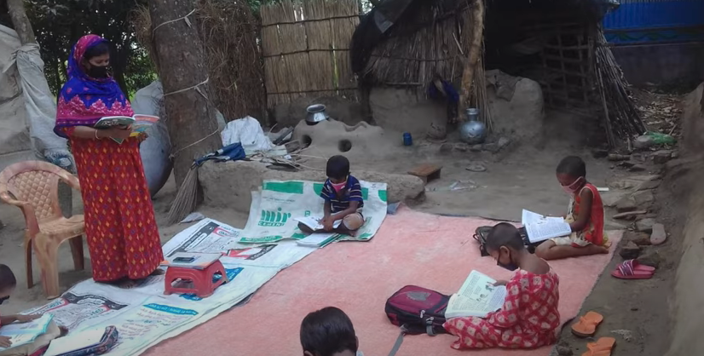
Social distance

Slide 9
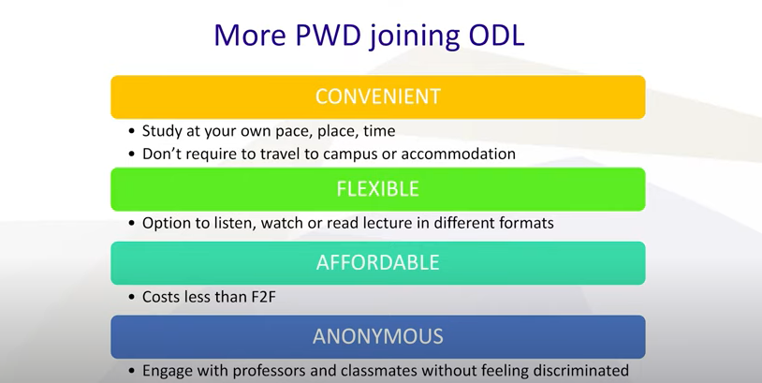
More PWD joining Open & Distance Learning (ODL)

Slide 10
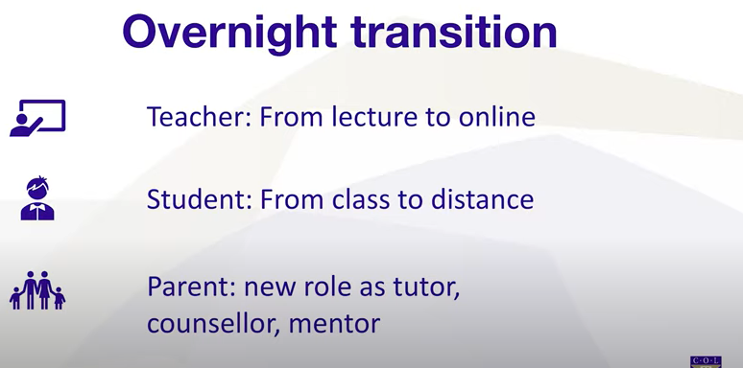
Pedagogical Challenge

Slide 11

3 Type Content

Slide 12
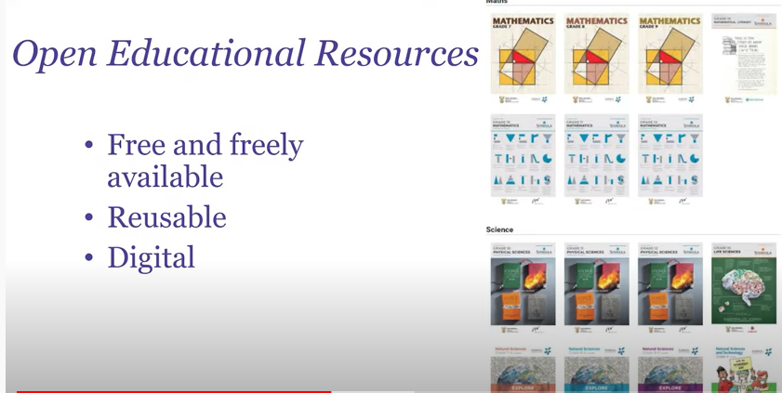
Quality Contents

Slide 13
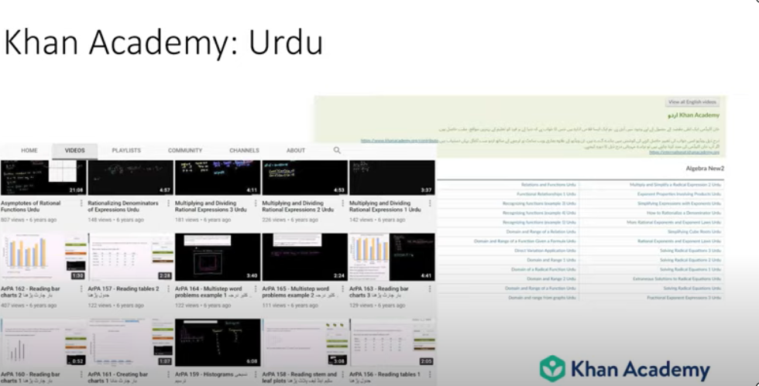
Khan Academy USA

Slide 14

Learner & Learning Support

Slide 15
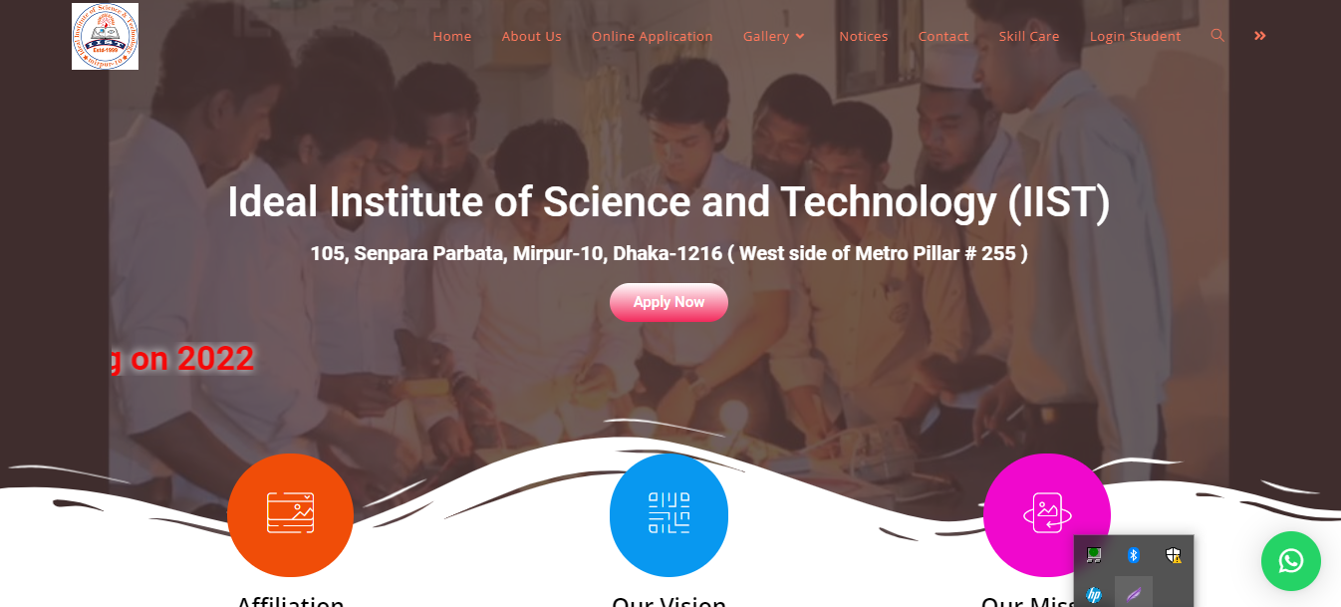
IIST Mirpur-10, Dhaka-1216
Ideal Institute of Science & Technology (IIST)

Slide 16
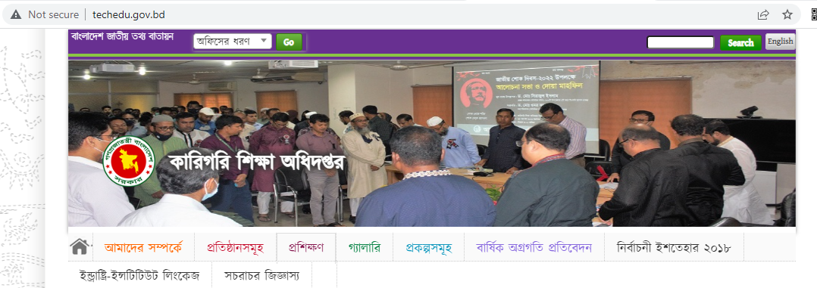
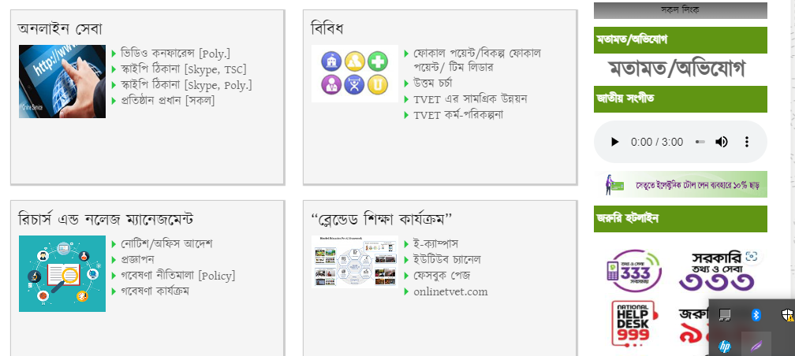
LMS E-CAMPUS DTE, BANGLADESH

Slide 17

LMS E-CAMPUS DTE, BANGLADESH

Slide 18
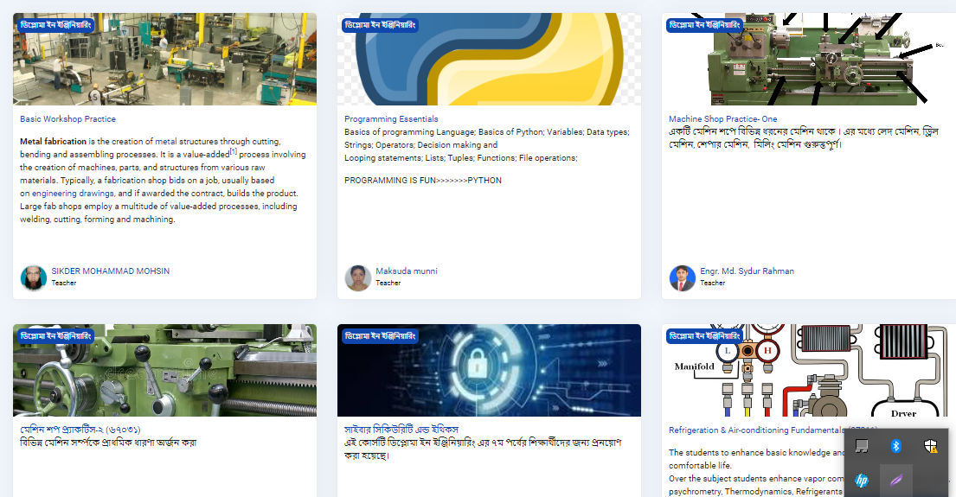
LMS E-CAMPUS DTE, BANGLADESH

Slide 19
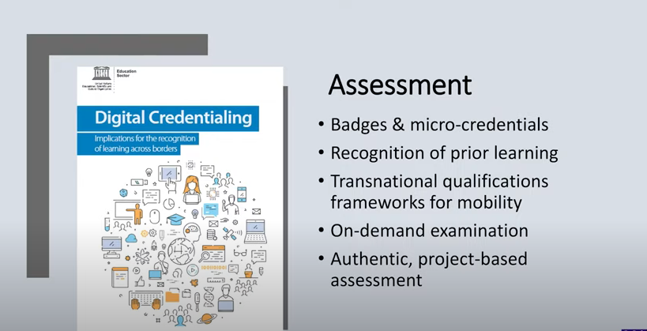
Assessment

Slide 20

Blended Learning

Slide 21
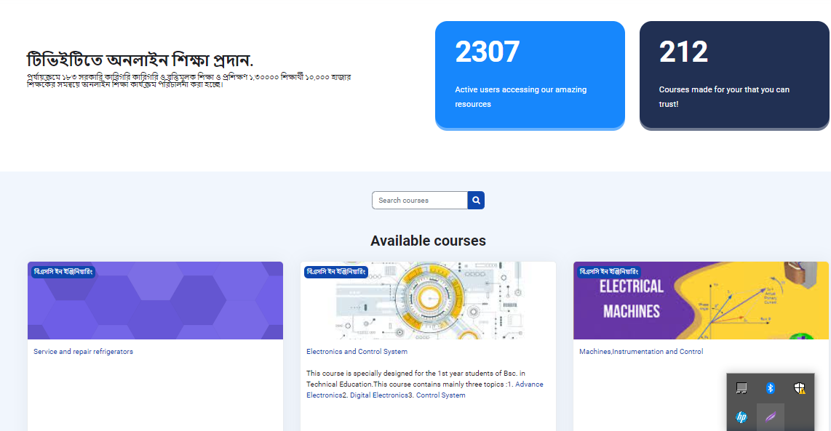
Tele School TV BANGLADESH

Slide 22
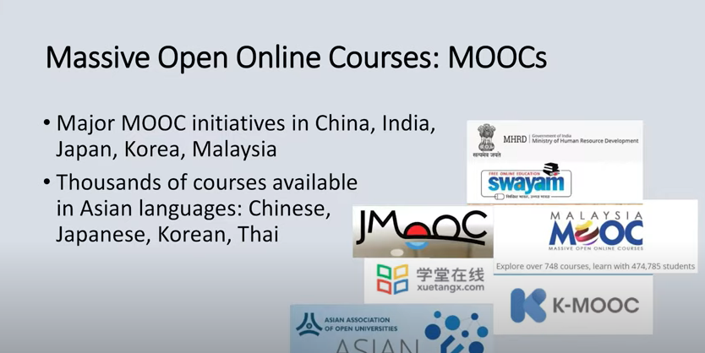
Online Courses

Slide 23

Mobile

Slide 24
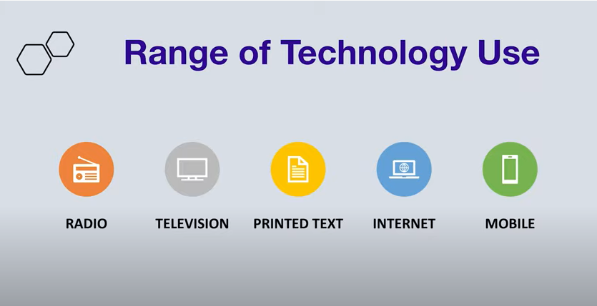
Range of Technology uses

Slide 25

Online Safety

Slide 26
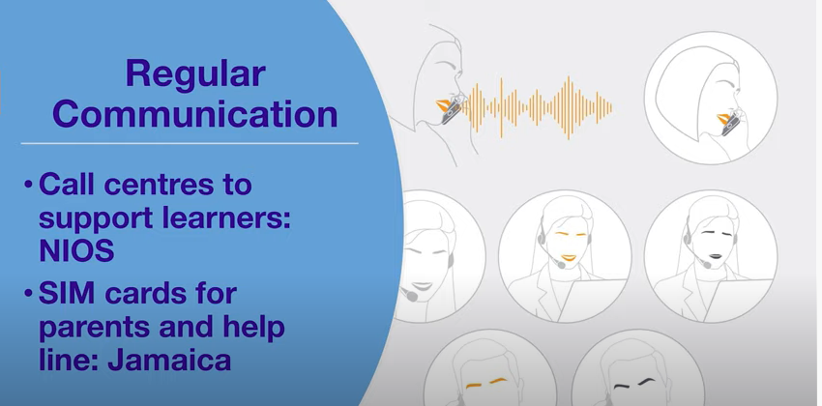
Regular Communication

Slide 27

3 C

Slide 28

Connectivity

Slide 29
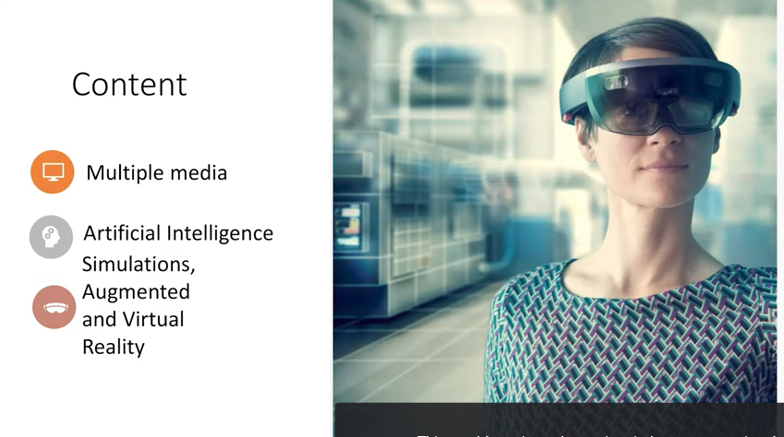
Mindset

Slide 30

Multiple Media (Web Development Level-4)

Slide 31
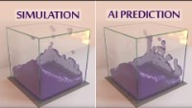
Artificial Intelligence Simulation

Slide 32
How Augmented Reality (AR) Is Transforming The Education Industry
Augmented Reality (AR) continues to grow rapidly, with an estimated
3.5 billion mobile AR users worldwide in 2025, up from 2.4 billion in 2023.
Although AR is widely recognized through popular games like Pokémon Go and
social media platforms like Snapchat and Instagram, its applications extend well
beyond entertainment.
One of the most promising areas for AR is education and eLearning,
where this technology has the potential to transform learning experiences
and boost engagement

Slide 33
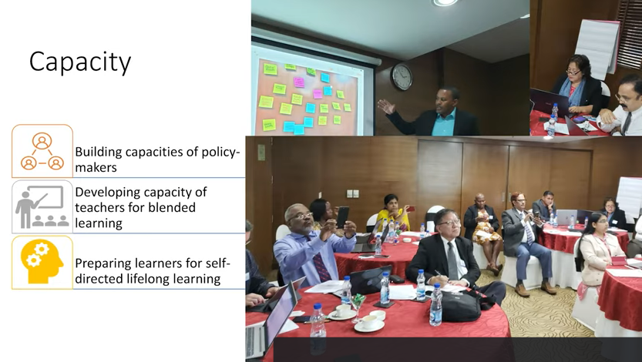
Capacity

Slide 34
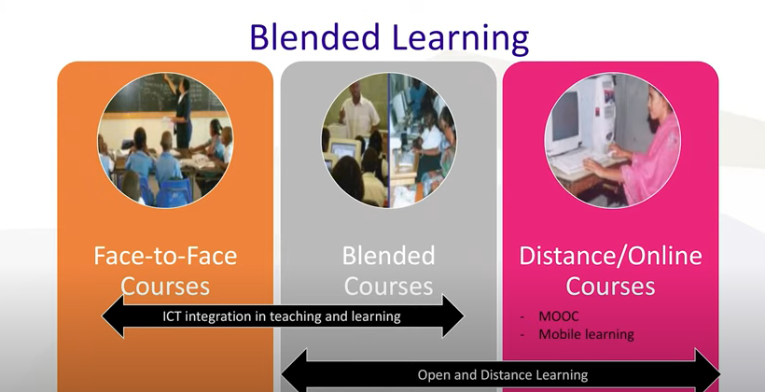
Blended Learning

Slide 35
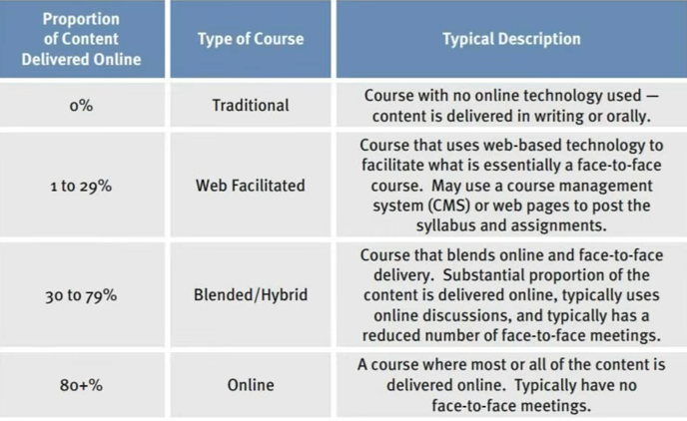
Options

Slide 36

Best Wishes to All

